Slide 1
Emergence of Bangladesh
North South University
Dhaka, Bangladesh
HIS 103

Slide 2
Welcome Colonial Drug Trade in Bengal & South Asia By Dr. Saleh Md. Shahriar Assistant Professor (Full-Time) Initial: SAMS DHP, NSU

Slide 3
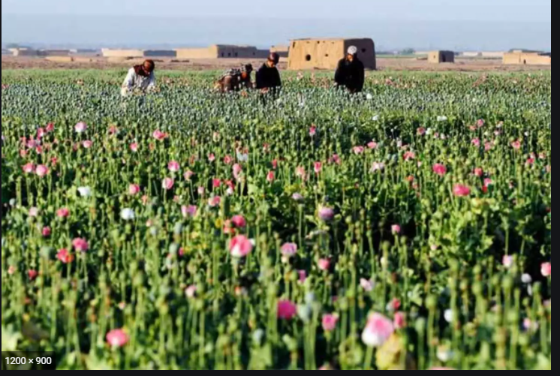
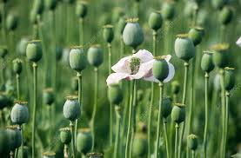

Poppy cultivation

Slide 4
1. The Golden Triangle: Eastern part of Myanmar’s Shan state, areas of northern Thailand and northern Laos, bordering southwest China 2. The Golden Crescent: consists of northeastern and southern Afghanistan, NWFP of Pakistan and Shistan Baluchistan of Iran. 3. The Golden Wedge :consists of northern India (Himachal Pradesh, Uttar Pradesh & Arunachal Pradesh), parts of Nepal and Bhutan
THREE MAJOR DRUG-PRODUCING REGIONS:

Slide 5
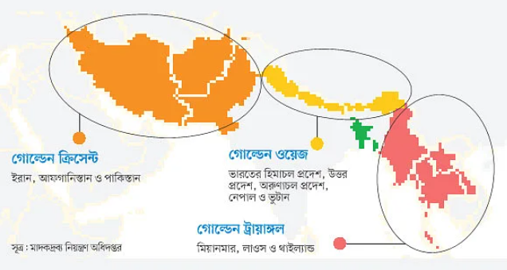

Slide 6
Channel I Tritio Matra -Interview of NSU professor M. Emdadul Haq:
https://m.youtube.com/watch?v=qJrY0YpcPTE

Slide 7
Poppy has been extensively cultivated in the mountainous areas of Myanmar, Laos, Southern China, and Vietnam since the nineteenth century. By the late 1980s and early 1990s, Southeast Asia had become one of the most significant opium and heroin producing and trafficking regions in the world.
Six countries—Cambodia, China, Laos, Myanmar, Thailand, and Vietnam—are part of a geographical region known as the Greater Mekong Sub-region (GMS), approximately 12,000 km2, which is acknowledged as one of the world’s major locations for production of illicit drugs, including heroin and ATS.
Drug trade for profit-making

Slide 8
1. Through the dealings of the British East India Company, opium, traditionally used medicinally, became a non-medicinal business commodity during the late eighteenth and throughout the nineteenth centuries. 2. For capital formation, as well as to run the administration, the colonial government in India continued the supply of opium to China throughout the nineteenth century.

Slide 9
The land under poppy cultivation was increased from 283,000 hectares in 1765-6, to 303,500 hectares in the following year.
This large-scale conversion of paddy fields into poppy cultivation contributed to a famine in Bengal in 1770.
This famine caused the death of 10 million in an area that had been traditionally known as the 'Golden Bengal' due to its natural resources.

Slide 10
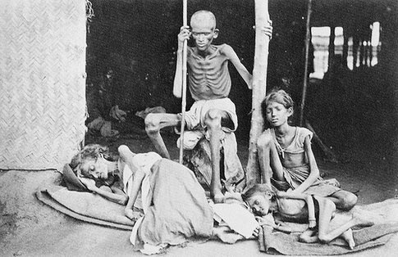
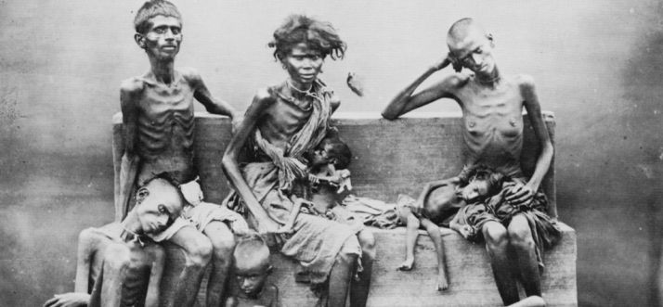
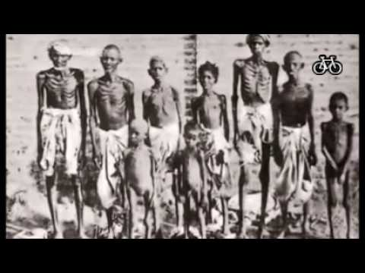

Slide 11
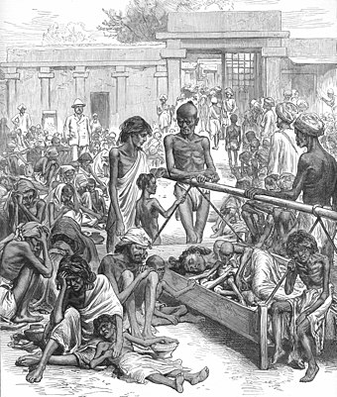
People in the famine stricken Bengal in 1770 after their paddy fields were converted by the BEIC for poppy cultivation

Slide 12
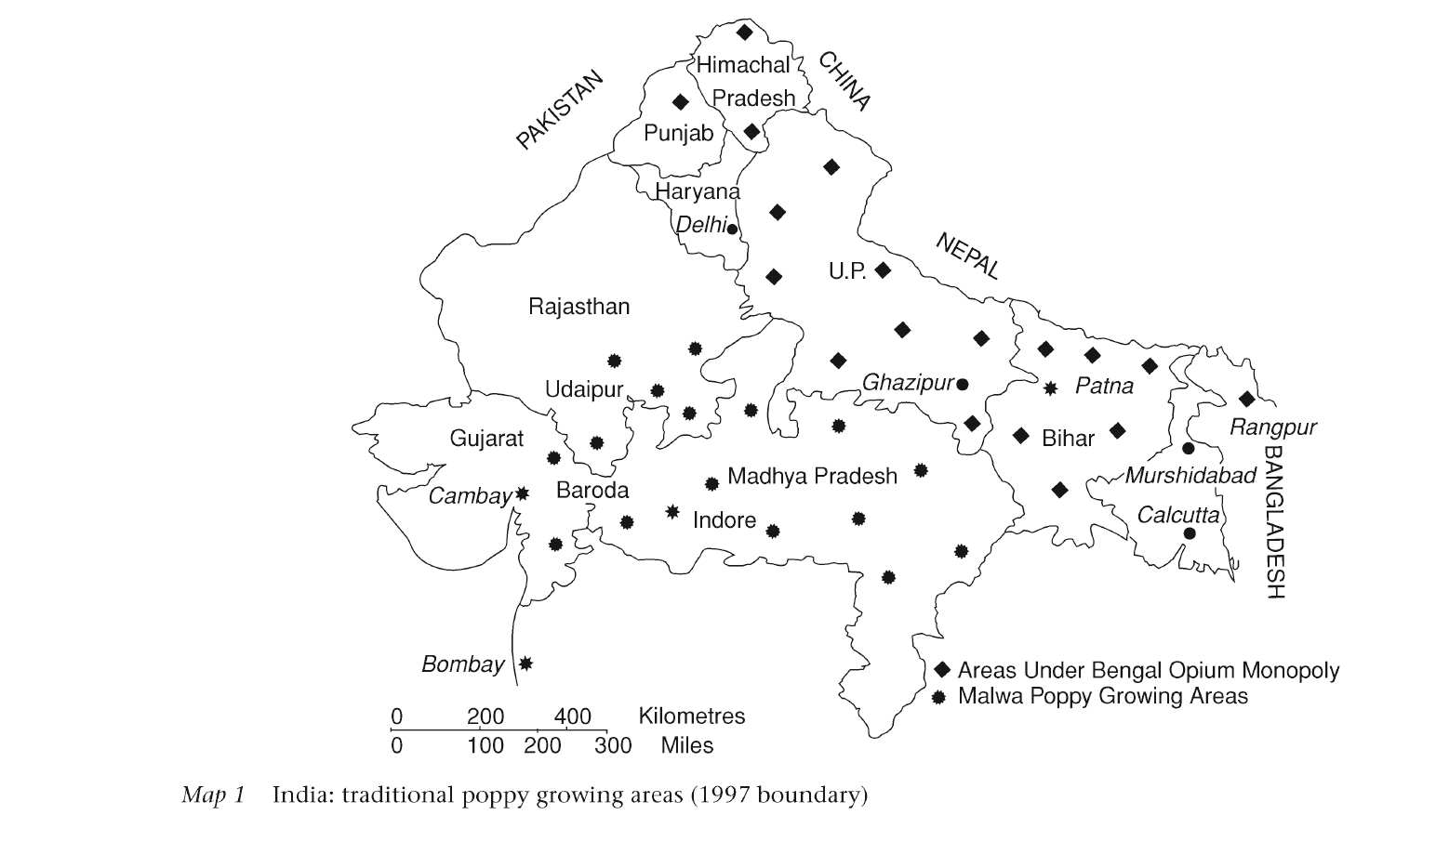

Slide 13
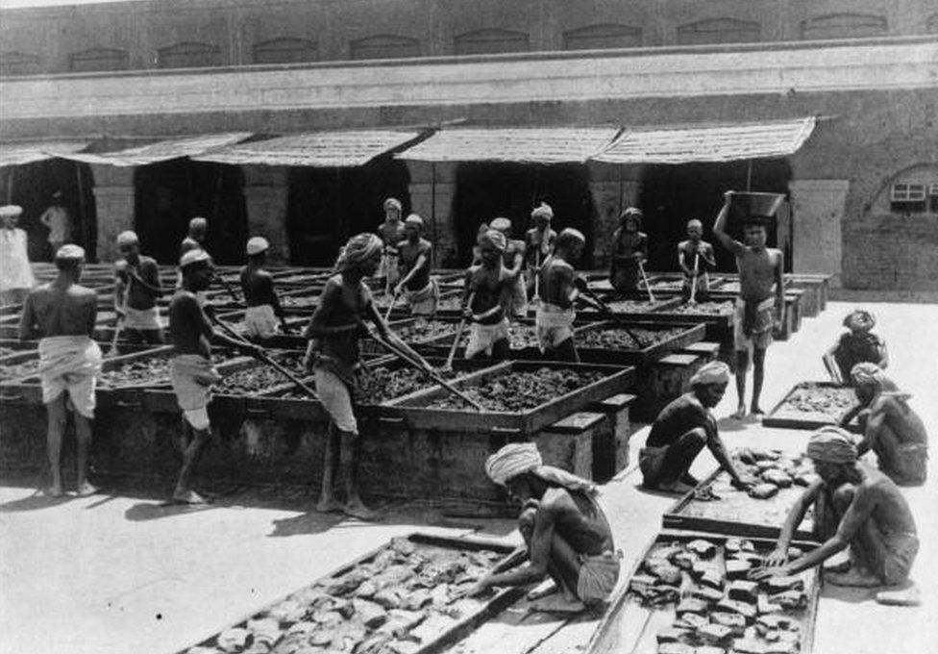
The process of monopoly opium in colonial India

Slide 14
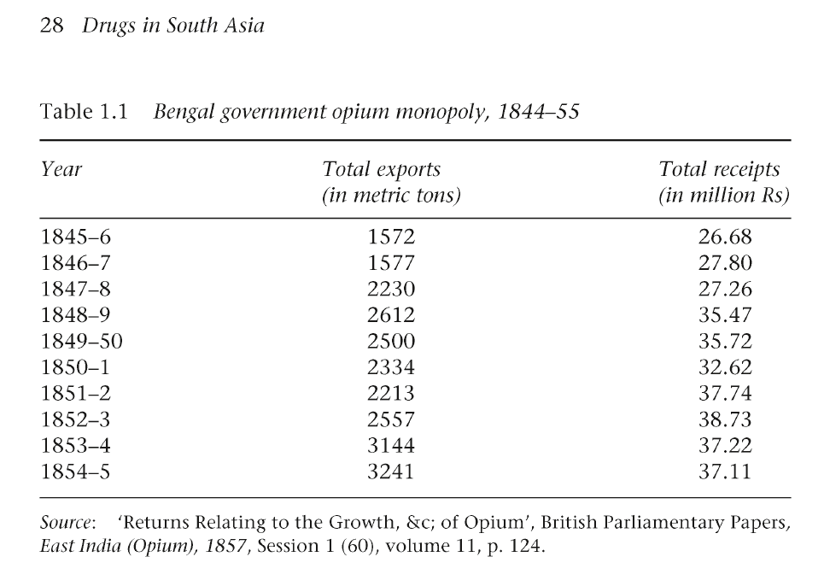

Slide 15
Under the Opium Act of 1857, the cultivation of poppy and manufacture of opium went under the direct control of the Bengal administration and the Board of Revenue at Calcutta.
Subsequent to the initial battles for Opium, Bengal became springboard for British colonial expansion in different directions.
After the Boxer war in 1764, the BEIC annexed areas one after another which became strategically important to them to maintain their supremacy in the regional opium traffic.

Slide 16
As a result of the US's Cold War in Afghanistan, combined with the Pakistani perception of a threat to its territorial integrity in NWFP and Baluchistan, the Pathan cultivators produced record-breaking illicit opium in 1979.
The tunneling of drug money into the politics of insurgency has to institutionalize the drug trade in Pakistan.

Slide 17
The relationship between demand and supply is not entirely linear, but demand for heroin may be linked in part to the resurgence of opium production.
Among people using heroin, those who inject drugs are one of the most vulnerable and marginalized groups, a substantial cause of disease burden, and a contributor to blood-borne virus transmission

Slide 18
Narcotics trafficking is more than transnational, it is global. Trafficking in opium, cannabis, and cocaine has been shifting and diversifying, and to these have been added amphetamine-type stimulants (ATS) and new psychotropic substances (NPS).
Statistics show that approximately 10.6 million people injected drugs worldwide in 2016, or 0.22% of the global population aged 15–64.
Around 7.5 million people addicted to drugs in Bangladesh.
Around 43% of the unemployed population of the country are addicted to drugs.

Slide 19
Indian official reports claimed that the obstacles in the Iranian and Central Asian routes in the early 1980s saw Pakistani traffickers increasingly use India as a transit route for overseas destinations.
Bangladesh is used a transit route for illicit drug trafficking
Drug gangs use Rohingya to get the Yaba into southern Bangladesh
The rise of organized drug cartels in Bangladesh. It has larger security and geopolitical implications
Drug money is used for running insurgent movements in the Chittagong Hill Tracts (CHT) as the region has geo-strategic importance.

Slide 20
The increasing demand for yaba has been a matter of grave concerns to the social scientists and policy makers of Bangladesh. In 2018, Bangladeshi authorities seized 53 million yaba tablets nationally. The total value of this illicit business is estimated to be worth upwards of $1bn a year
Some fishermen, farmers and traders in Cox’s Bazar and Teknaf were consequently drawn into a corrupt network of yaba smuggling, involving also Rohingyas (Hasan, 2019).

Slide 21
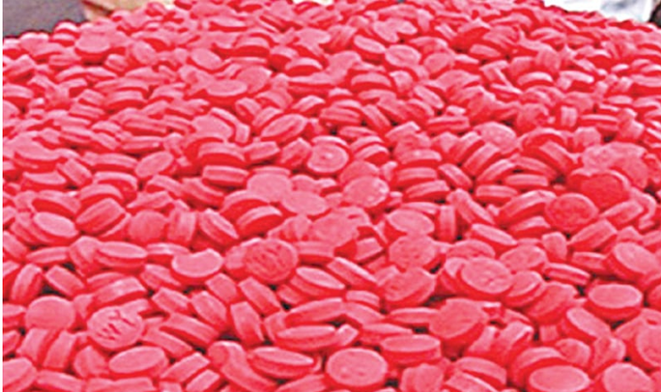

Slide 22
According to a report, at least 15 influential persons of Rajshahi are engaged in trading and smuggling drugs into the country, says a home ministry report ( Source: https://en.prothomalo.com/bangladesh/AL-MP-patronising-drug-trade).

Slide 23
The government of Bangladesh has adopted a zero-tolerance policy towards drug use, which law enforcement agencies have striven to reinforce.
Bangladeshi Narcotics Control Act of 2018 mandated the death sentence or life imprisonment for individuals carrying methamphetamine for illicit use (S. I. Khan et al., 2019).
In May 2018, Bangladesh Prime Minister Sheikh Hasina announced a drug war, leading to over 300 killings and 25,000 arrests. In justifying her campaign, Hasina spoke of drugs as a “deadly disease” alongside corruption and militancy (Lascoa, 2020).

Slide 24
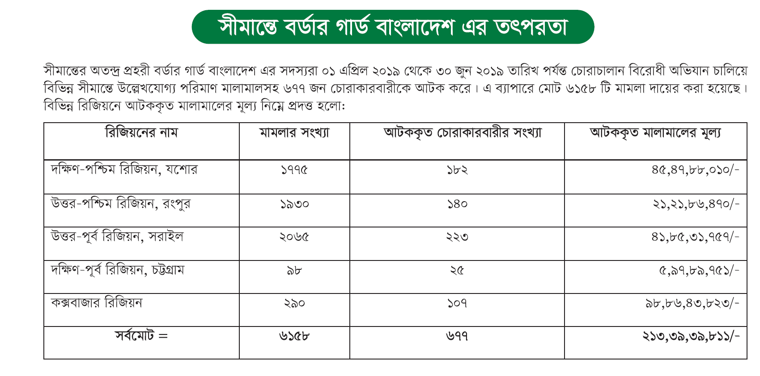

Slide 25
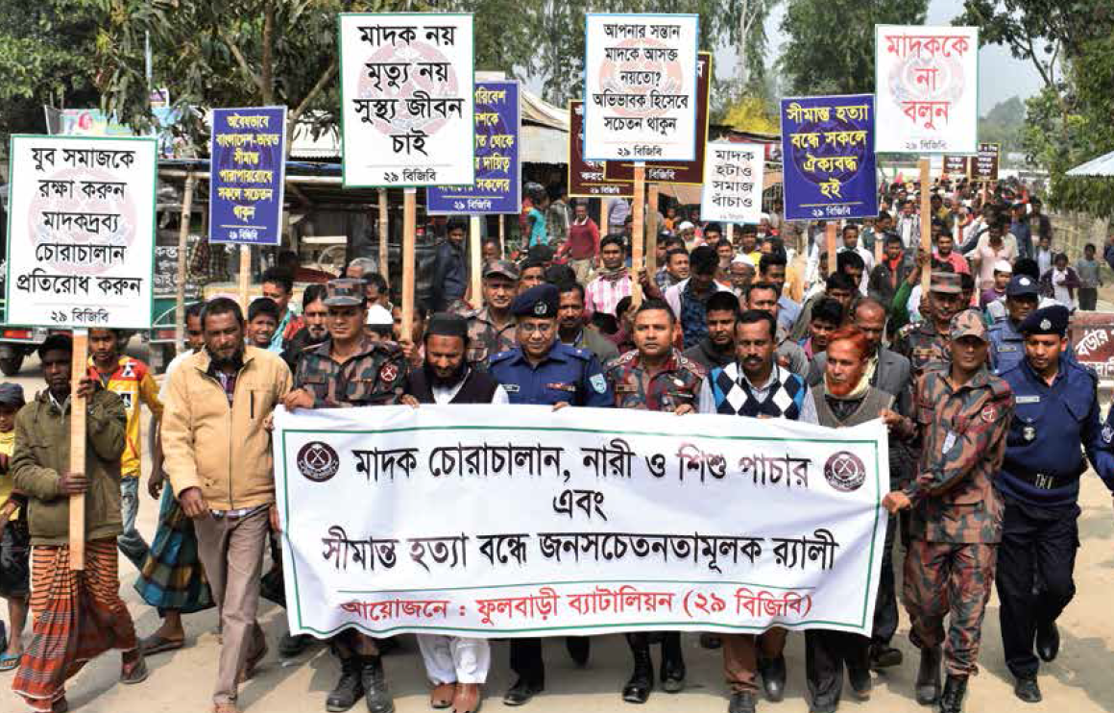

Slide 26
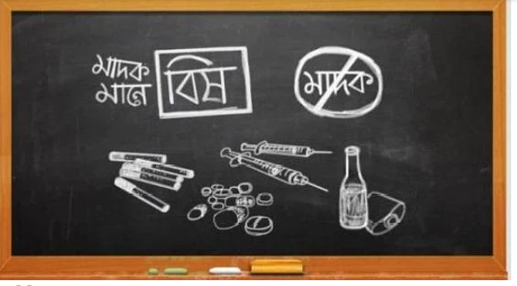

Slide 27
Causes :
Poverty
Demographic dividend
COVID-19 & unemployment
Profit making motive
Narcotics geopolitics
Lack of Cross-regional & inter-state cooperation
Illiteracy
Climate
Loose law & order situation

Slide 28
What should be done ?
Demand reduction
Supply chain disruption
Rehabilitation
Solving Rohingya Refugee crisis
Money laundering control & Punishment
Border control
Jobs creation
Sustainable livelihoods framework (SLF)
Education & Awareness building programs
Family bond & values
Follow UN conventions

Slide 29
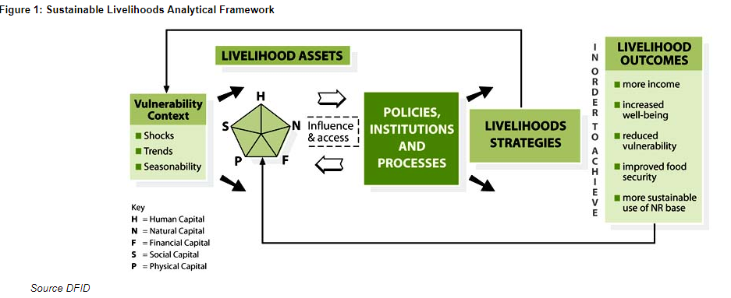

Slide 30
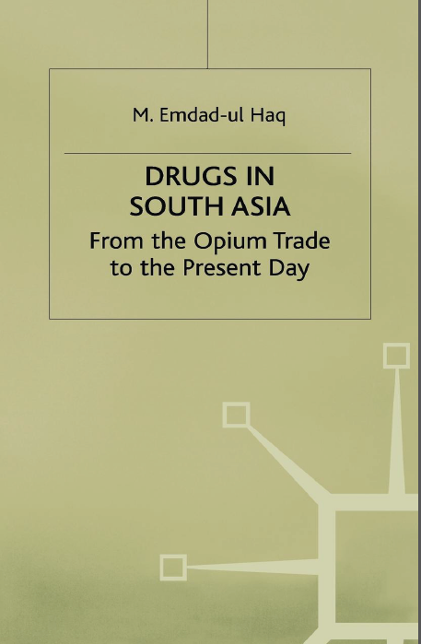
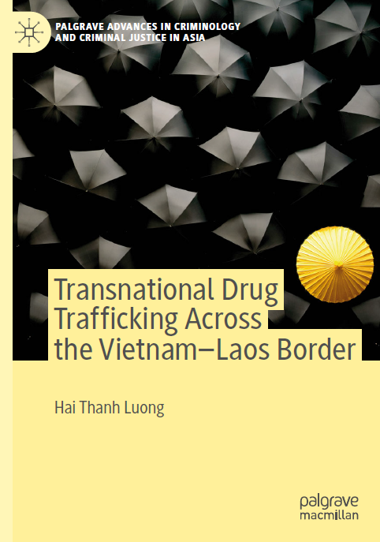
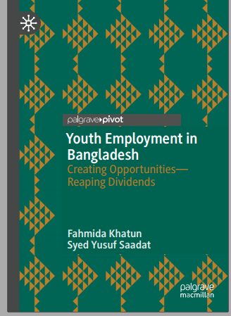
References:

Slide 31
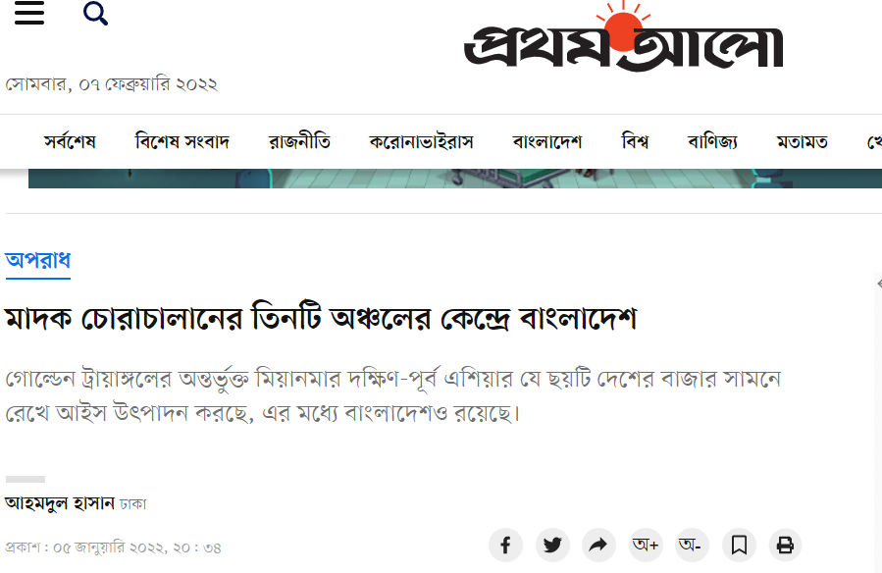

Slide 32
